Slide 1
RMIT VN Requirements Gathering Session
Vietnam
<date of workshop>

Slide 2
Overview
Current Business Process
Company Structure
Employee Structure
Pay Frequencies
Payment Details
Salary/ Levels/ Bands
Deductions
Work Patterns
Absences/ Quotas
Taxation Details
Social Insurance
Banking
General Ledger
Interfaces
Payslips
ESS (Employee Self Service)

Slide 3
Current Business Processes
Input (Sources & timings)
Calculation
Timelines
Outputs (reports etc)

Slide 4
Company Structure
Company Code
Legal Entity
P+L Statements
Balance Sheets
Personnel Area
City/ State
Sub Area
Further breakdown of personnel areas.
Controls public holiday groupings/ work schedule groupings/ business place and section code details

Slide 5
Company Structure (cont)

Slide 6
Employee Structure
Employee Group
Employee employment status such as Permanent/ Contractors/ Trainees/ Expatriates/ International Assignees etc.
Employee Subgroup
Further breakdown of EE Subgroup
Controls payroll calculations (e.g. between casual EE’s and salaried EE’s, Wagetype groupings etc.

Slide 7
Employee Structure (cont)

Slide 8
Pay Frequency
Groups employees for payrun purposes. Controls when an employee will be paid/ dates of the periods that EE’s are paid for.

Slide 9
Payments
Details of all payments made to employees
Payment Codes
Table to be entered in
New Starter/ Leavers
Calculations
Taxable etc
Payslips

Slide 10
Salary Levels/ Bands
If the company has multiple salary levels etc – these can be recorded in payscale type/ area/ groups and levels. If certain payments are made to only certain grades, these will have to be grouped.

Slide 11
Deductions
Details of all deductions made to employees
Deduction Codes
Table to be entered in
New Starter/ Leavers
Calculations
Taxable etc
Payslips

Slide 12
Work Patterns
Details of work patterns for employees
Start and End Times
Breaks
Public Holidays
Starters and Leavers

Slide 13
Absences
Details of all absences that are tracked in the payroll system.
Details of all limits to absences – e.g. Annual Leave etc.

Slide 14
Taxation Details
Tax Groupings

Slide 15

Social Insurance
Social Insurance Schemes
Contribution Percentages

Slide 16
Severance Allowance
Severance Allowance =
Total duration of employment x Wages used for calculate severance payment x 1/2
Provide a list of Wage code used for severance payment
Formula to calculate the wages based

Slide 17
Minimum Take Home Pay
Minimum Take Home Pay Cap amount

Slide 18
Banking
Bank account details – sample file formats etc.

Slide 19
General Ledger
Posting Details, file formats etc.

Slide 20
Interfaces
Details of any interfaces that will be used with this system
Inbound (HR)
Outbound (GL/ Banking etc)

Slide 21
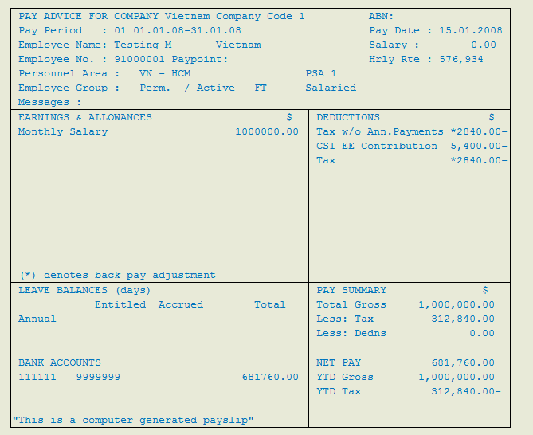
Payslip Layout
Add sample payslip – either standard form or Smartform

Slide 22
ESS (Employee Self Service)
Include services from client contract for discussion

